Slide 1
Natural Language Processing (CSE431/CSE712)
Group-4
Md Faisal Ahmed ID: 21341042
Md. Tawhid Anwar ID: 21166002
Sifat Tanvir ID: 21166031
Ramkrishna Saha ID: 21166004
Syed Zamil Hasan Shoumo ID:21166008

Slide 2
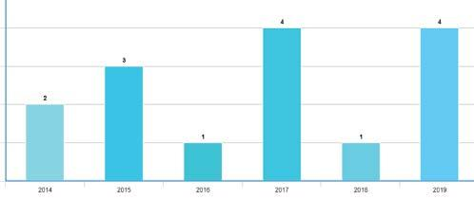
NLP based Machine Learning Approaches for Text Summarization
Authors: Rahul, Surabhi Adhikari, Monika
Distribution of papers studied over years

Slide 3

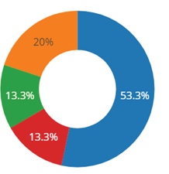
Analyzed papers
Author’s Name | Year of publication | Methods used | Dataset used
Kamalanathan Kandasamy et. Al | 2014 | URL analysis, NLP, & Supervised, ML Techniques | Tweets from Users
Mohamed Abdel Fattah | 2014 | k—means clustering, Differential evolutionary algorithm | Datasets from DUC200 1 and DUC200 2
Mr. Sarda A.T. et al | 2015 | NN, ML, RST | Input text documents
Gabriel Silva et al | 2015 | STOM, CSF, Information Gain Evaluator and SVM attribute | news texts from CNN corpus
K. Vimal Kumar, et al | 2015 | Sentence ranking, Sentential semantic analysis and Sentence extraction | Hindi text Single documents
Rasim Alguliyev | 2016 | Human Learning Optimization Algorithm | Takes a document as input.
Taeho Jo | 2017 | k-nearest neighbor algorithm | Input paragraph
Types of Summaries Studied

Slide 4
Machine Learning Approaches
Supervised ML Algorithms used in NLP
Support Vector Machines
Bayesian Networks
Maximum Entropy
Conditional Random Field
Neural Networks/Deep Learning
Unsupervised ML Algorithms used in NLP
Latent Semantic Indexing (LSI)
Matrix Factorization
Concept Matrix
Syntax Matrix

Slide 5
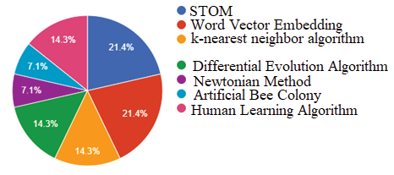
Text summarization techniques
- ML technique to classify spams on twitter.
- CNN, RNN to generate text summaries
- Newtonian method to generate key phrases
- binary approach for EXT text summarization
Algorithms used for text summarization

Slide 6
Conclusion and Future works
- Relevant text summarization
- Use of GANs and transfer learning
- Develop and enhance further ideas

